Slide 1
Tifare Part

Slide 2
My question(s)
Does the interest rate of loans taken by lending club members react to the market in 2018?
Does the market affect the number and/or amount of money being taken out in 2018?

Slide 3
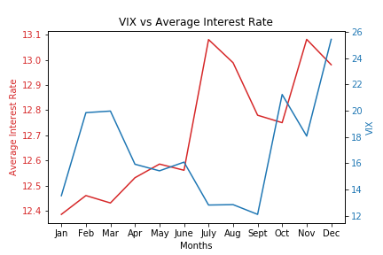
Data Analysis for Q#1
This graph shows

Slide 4
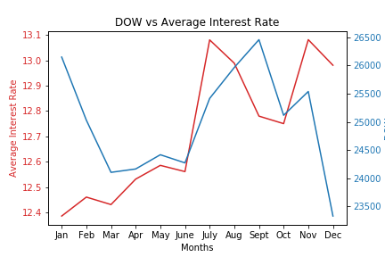
Data Analysis for Q#1

Slide 5
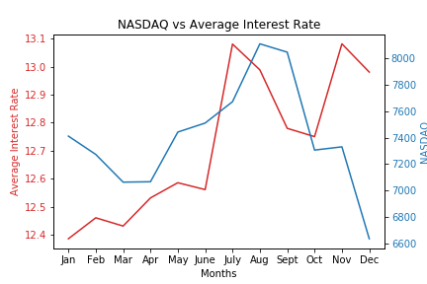
Data Analysis for Q#1

Slide 6
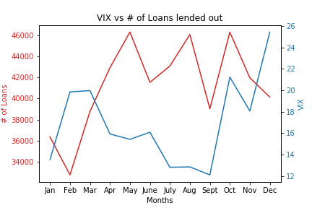
Data Analysis for Q#2

Slide 7
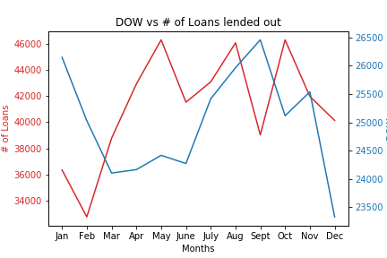
Data Analysis for Q#2

Slide 8
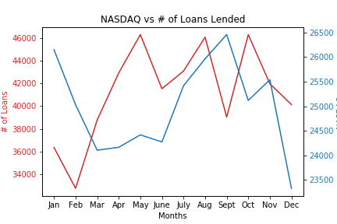
Data Analysis for Q#2

Slide 9
Conclusions
NASDAQ

